Slide 1

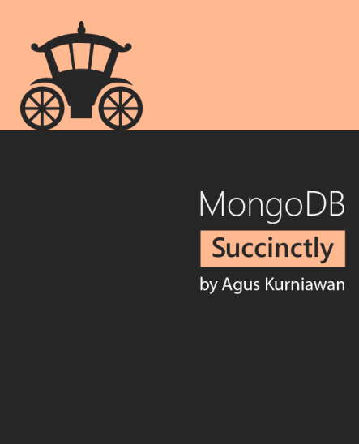

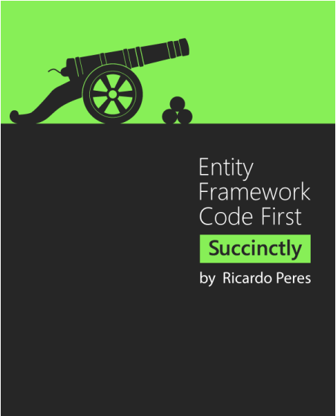
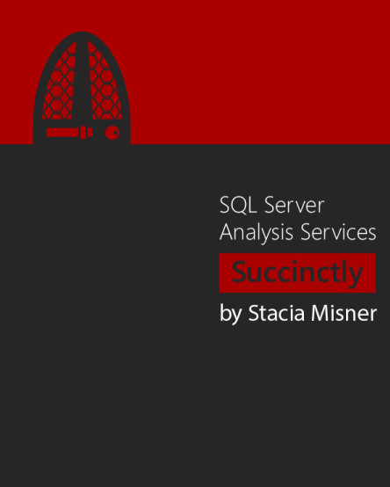
Topic 4

Slide 2
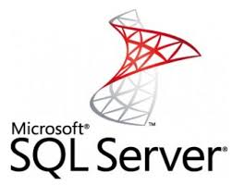

Slide 3
Introducing
Microsof SQL Server is a relational database management system developed by Microsorf.
It’s software product with the primary function of storing and retrieving data as requested by other software applications.

Slide 4
What is database?
A Database (Database) is a data collection was organized arrangement. The main purpose of the database is to organize large amounts of information in the storage, collection, and management.

Slide 5
Syntax
All the SQL statements start with any of the keywords like SELECT, INSERT, UPDATE, DELETE, ALTER, DROP, CREATE, USE, SHOW and all the statements end with a semicolon (;).
Important point to be noted is that SQL is case insensitive, which means SELECT and select have same meaning in SQL statements.

Slide 6





Clause in SQL
Where Clause
And/Or Clause
Between Clause
Top Clause

Slide 7
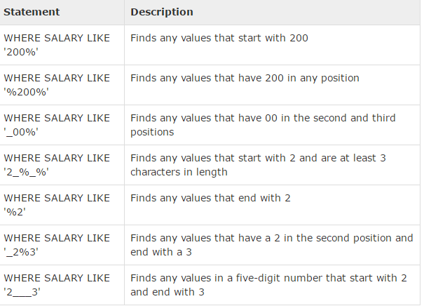
Clause in SQL
Like Clause:

Slide 8

Group basic operations command
Select query
Example:

Slide 9




Group basic operations command
Insert query

Slide 10




Group basic operations command
Update query

Slide 11


Group basic operations command
Delete query

Slide 12




Group basic operations command
Order by
The SQL ORDER BY clause is used to sort the data in ascending or descending order, based on one or more columns.

Slide 13

Group basic operations command
Group by- Having
Clause GROUP BY in SQL is used in combination with the SELECT command to sort data into groups homogeneous.

Slide 14

Group basic operations command
Group by- Having
The HAVING clause enables you to specify conditions that filter which group results appear in the final results.
The HAVING clause must follow the GROUP BY clause in a query and must also precede the ORDER BY clause if used.

Slide 15

Group basic operations command
Distinct keyword
Keywords DISTINCT in SQL is used in combination with the SELECT command to remove all copies of the records and just get the unique record.

Slide 16
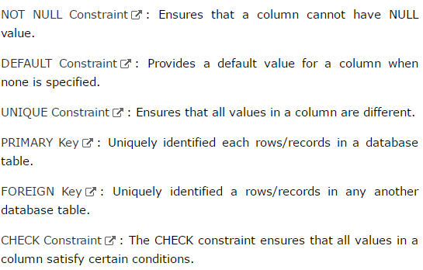
Constraints

Slide 17
Join
The SQL Joins clause is used to combine records from two or more tables in a database. A JOIN is a means for combining fields from two tables by using values common to each.

Slide 18
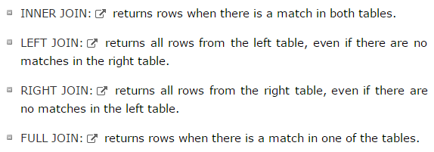
Join
Join types

Slide 19

View
A view can contain all the rows of a table or selected rows from a table. A view can be created from one or more tables, depending on the SQL query to create a view wrote.

Slide 20

Trigger
Every time there is a change of data in a data table, or specific operations, handling using commands such as: insert, update, delete, alter Trigger will be called.

Slide 21
Store Procedure
As a language to perform operations on databases such as the creation of structures in the database, supplement, update, delete, and query data in the base data.
Can have:
Declare variable
The control structures (IF, WHILE, FOR)
Parameter

Slide 22
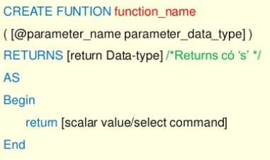
Function
Functions include multiple SQL statements combined into one group, and an object for use as a component function of the expression in the query or update data.
The function always returns values through the function name.(Table-valued Functions, Scalar-valued Functions)

Slide 23
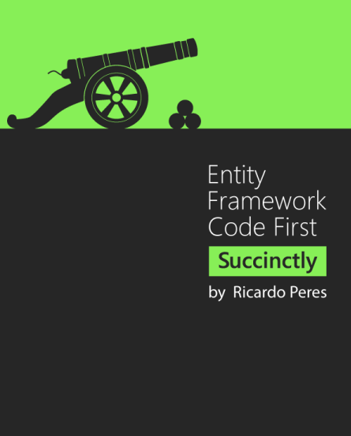

Slide 24
Introducing Entity Framework Code First
EFCF is the latest edition of Microsoft’s flagship data access technology
It sits on the “classic” Entity Framework, Which existed since 2009.
Entity Framework already offered two development models:
Database first, which generated code from an existing database.
Model first, which defined a conceptual model from which both the database and the code were generated.
EFCF: Starting by code and generating the database from it.

Slide 25
Why EFCF?
We can set up EFCF from Nuget
It’s an API for database access and we can expect to see more support and improvement for by Microsoft.
EFCF is not tied to .NET framework releases

Slide 26
Why EFCF?
EFCF will connection to use by executing the following algorithm:
If a connection string is passed in the DbContext’s constructor, then it will try to use that connection string with the default connection factory.
If the parameter-less constructor is used, it will look for a connection string in the configuration file, where its name is the same as the context’s class.
If no connection string is passed and no connection string with an appropriate name is found in the connection string, it will try to connect to a SQL Server instance named SQLEXPRESS, and a database with the same name as the context class, including namespace

Slide 27
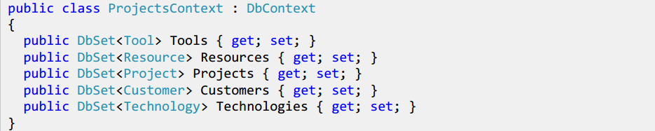
Domain Model
Context: A context is a class that inherits from DbContext and which exposes a number of entity collections in the form of DbSet<T> properties.
Context: A context is a class that inherits from DbContext and which exposes a number of entity collections in the form of DbSet<T> properties.

Slide 28
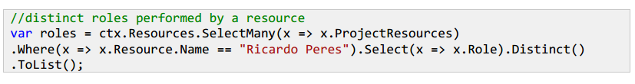
Getting Data from the Database
By Id:
var getStudentById = ctx.Students.Find(1); // A primary key
var getStudentById = ctx.Students.Find(1, 10); // Composite primary keys
Distinct:
Check record existence:

Slide 29
Getting Data from the Database
Take – Skip
GroupBy
…

Slide 30
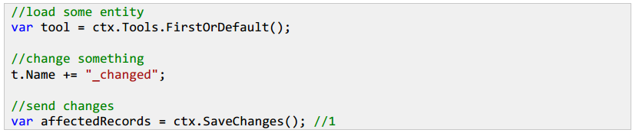
Writing Data to the Database
Saving Entities
Updating Entites
Upserting Entities

Slide 31
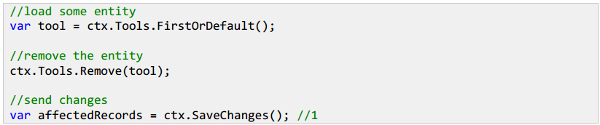
Writing Data to the Database
Deleting Entities

Slide 32
Performance Optimizations
- Entity Framework works with two flavors of LINQ:
LINQ to Objects: operations are performed in memory.
LINQ to Entites: operation are performed in the database.
Ex:
// LINQ to Objects
var linqObject = db.Students.ToList().Where(x=>x.Name = “Roger”);
// LINQ to Entites
var linqEntity = db.Students. Where(x=>x.Name = “Roger”).ToList();

Slide 33
Use Lazy, Explicit or Eager Loading
SELECT N+ 1: you issue one base query that returns N elements and then you issue another N queries, one for each reference/collection that you want to access.
Using eager loading by applying the Include extension method.
Ex:
// Eager loading
var EagerLoading = db.Students.Include(x=>x.Name).ToList();

Slide 34
Use Projections
Projections allow us to reduce queries return.
Ex:
var linqProjection = db.Books.Select(x => new { name = x.AuthorName });

Slide 35




MongoDB

Slide 36
Introducing
MongoDB (from humongous) is a free and open-source cross-platform document-oriented database program.
MongoDB is developed by MongoDB Inc.
Starting develop since 2007 by the company 10gen and move to open source with the company providing commercial support and other services in 2009. In 2013 it was renamed MongoDB Inc.

Slide 37
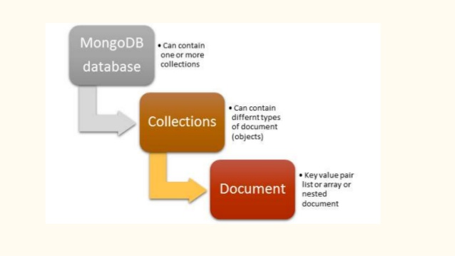
Introducing
What is a database?
Database is a data storage cell at the physical level, each database will have more collection and storage is set somewhere in the server computer.
What is collection?
Collection of documents MongoDB is heading, it is equivalent to a conventional database tables. However, it is a difference that is it has no binding Relationship as other database management system should work very fast access.
What is the document?
Document can understand it like the record data in MySQL, but it is no difference as the pair (key => value) can not be the same in every document.

Slide 38
Compare RDBMS & MongoDB
RDBMS and MongoDB
(RDBMS : Relational Database Management System)
RDBMS | MongoDB
Database (.mdf, .ldf) | Database (.ns, .x with x = 1,2,3,4….)
Table | Collection
Tuple | Document
Columns, Rows | Keys, values
Indexes | Indexes
Views, Functions, Procedures, Contraints, Triggers
Primary Key | ObjectId
Foreign Keys
Login | User Authenticate

Slide 39
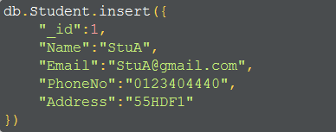
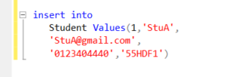



Some examples of queries in MongoDB
MongoDB SQL
Insert :
Select :
Where :

Slide 40
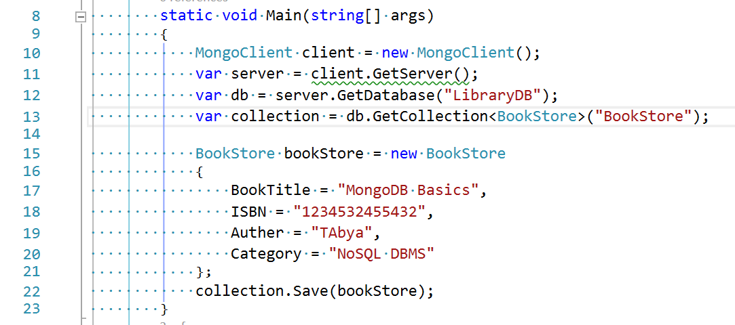
Simple example
Simple example of MongoDB :

Slide 41
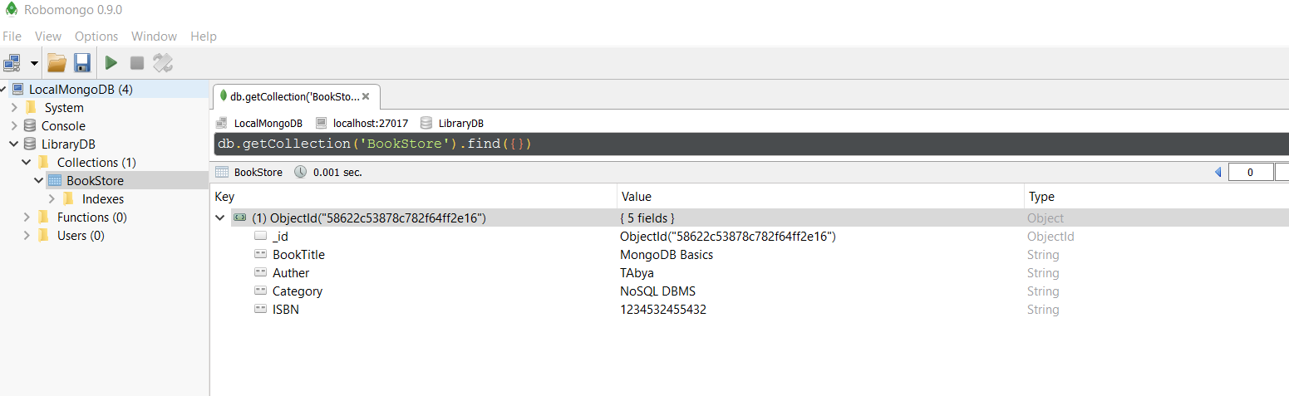
Simple example
Inspection results by robomongo
Robomongo is a shell-centric cross-platform open-source MongoDB management tool that embeds the same JavaScript engine that powers MongoDB's mongo shell

Slide 42
Simple example 2
Get a reference to the client object
Get a reference to the object Server
Get a reference to database objects
Get a reference to the object 1 Collection

Slide 43
Simple example 2
It is important to note :
The command line update: help update the input information
The command line remove will delete the Field in new created Collection
Command line save allows us to keep the operation just performed

Slide 44
Should You Use MongoDB?
How mongoDB is changing the business of big data
Store large volumes of data that often have little to no structure.
Make the most of cloud computing and storage.
Develop and release quickly.
Scale database architecture effciently and inexpensively.
MongoDB helps you make the most of modern data
Location-based data analytics and operations.
Get real-time data reporting and analytics.
Capitalize on sensor data and connected devices.
Powering content management systems (CMS).
Push out new versions of mobile apps fast.
Personalize data to tailor user’s experiences.
Is mongoDB right for your application ?
Your team’s existing skill sets and tools.
Your existing architecture and network infrastructure.
Location-based requirements.
Security requirements.
How much you expect your data to grow (and how soon).

